Slide 1
Identification of candidate genes and proteins in aging skeletal muscle(sarcopenia) using gene expression and structural analysis
Gita Shafiee, Yazdan Asgari, Akbar Soltani, Bagher Larijani and Ramin Heshmat
September 2018

Slide 2
Objective:
Discover the underlying genes, proteins, and pathways associated with sarcopenia between old and young skeletal muscles

Slide 3
Objective:
“ Most studies on sarcopenia focused on individual genes and lacked global data. Given that the main pathways interact with other mechanisms, an integrated look could be considered as an essential aim to identify hub genes and proteins–it may improve the clinical management of disease”
“According to this content, the onset of age-related muscle loss (sarcopenia) is developed by an imbalance between muscle protein synthesis and proteolysis. Sarcopenia is an age-related disease that has rapidly increased around the world”

Slide 4
Uncover the functions of the DEGs
Integrated analysis of microarray datasets
Differentially expressed genes (DEGs) between old and young skeletal muscles
Gene Ontology(GO) enrichment analysis
Kyoto Encyclopedia of Genes and Genomes (KEGG ) pathway enrichment analysis
Protein–protein interaction (PPI) network was constructed based on the DEG

Slide 5

Data attainment and pre processing
Gene Expression Omnibus (GEO; http://www.ncbi.nlm.nih.gov/geo/)
‘‘sarcopenia,’’ ‘‘muscle,’’ and ‘‘age.’
log2 transformation
quantile normalization
p-value < 0.05 and log fold change (FC) >2.0
Old vs Young / Male & Female

Slide 6
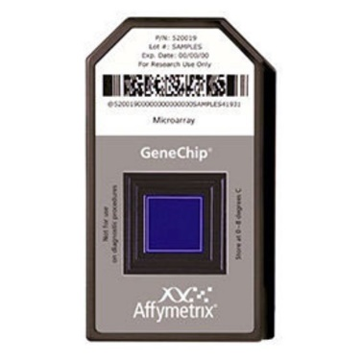
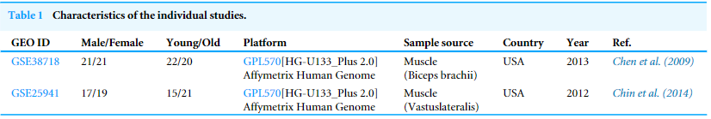
Selected studies
Non-human studies and reviews were excluded
GSE38718 (Liu et al., 2013)
GSE25941 (Raue et al., 2012)
GPL570 [HG-U133_Plus_2] Affymetrix Human Genome U 133plus 2.0

Slide 7
Detection of hub genes
the gene with the highest degree of connectivity in the key module
Cytoscape:
GeneMANIA (Gene-gene interaction)
cytoHubba (Hub genes location)
BisoGen (Protein-Protein interaction)
cytoHubba (centrality analysis)

Slide 8
Pathway enrichment analysis of DEGs
ToppGene (https://toppgene.cchmc.org/) (Chenet al., 2009)
InnateDB (http://www.innatedb.com/) (Breuer et al., 2013)
perform function prediction
gene ontology (GO)
KEGG enrichment analysis approaches

Slide 9
Results
41,715 DEGs in men
41,696 upregulated
19 downregulated
3,015 DEGs in women
2,874 upregulated
141 downregulated

Slide 10
Enriched GO terms
Negative regulation of molecular function
cytosolic ribosome
chemokine production
biological processes
lipid particle
molecular functions
RAGE receptor binding
cellular components
Notes:
the GO term for the cellular component was cytosolic ribosome; and serine-type endopeptidase inhibitor activity was significantly enriched for molecular functions.

Slide 11
KEGG pathway enrichment analysis
Pathway term | Gene count | P-value | FDR
Men
Ribosome | 8 | 9.05E−11 | 7.40E−10
Proteasome | 3 | 1.00E−04 | 5.79E−04
Amoebiasis | 3 | 0.001197846 | 0.001632358
Women
PPAR signalling pathway | 5 | 3.91E−07 | 2.15E−05
Adipocytokine signaling pathway | 2 | 0.010953677 | 0.035438366
Glycolysis/Gluconeogenesis | 2 | 0.010069903 | 0.036922978

Slide 12
PPI network
Men
1,189 nodes and 28,982 edges
Neurotrophic Receptor Tyrosine Kinase 1 (NTRK1, degree = 409)
Cullin 3 (CUL3, degree = 336)
P53 (degree = 276)
Female
454 nodes and 4,556 edges
NTRK1 (degree = 168)
CUL3 (degree = 133)
P53 (degree = 104)

Slide 13
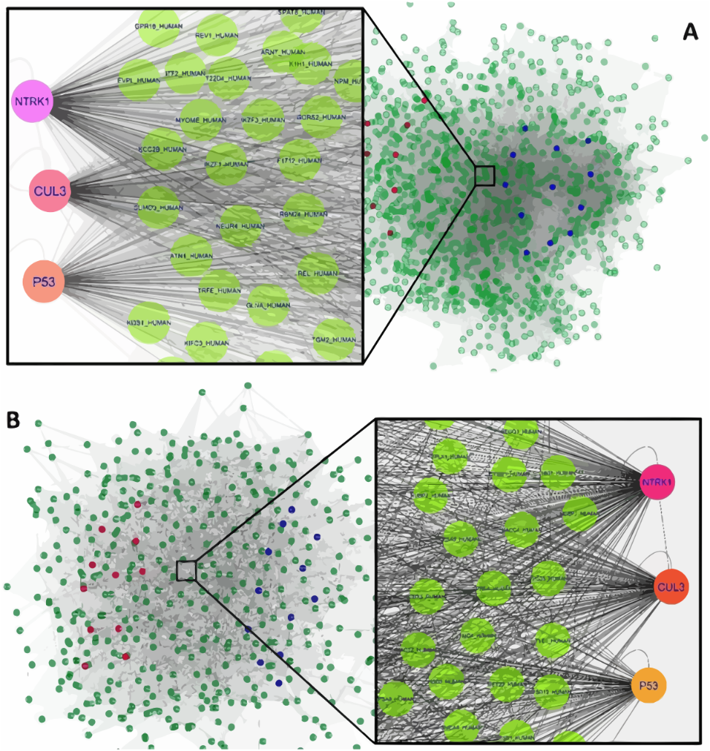

Slide 15
Discussion
They found that the genes involved in ribosome biogenesis, such as RPL24, RPS3, and other RPL families, were significantly upregulated with aging in old men
Ribosome has an essential role in the regulation of cell proliferation and growth and homeostasis in organisms (Chaillou, Kirby & Mccarthy, 2014).
Kirby et al. (2015) found that the greatest aged-related differences in the gene expression were RPL24 and especially RPL11.

Slide 16
Discussion
The expression of genes involved in lipid storage, such as, PLIN1, FABP4, and LPL, were upregulated in older individuals.
suggesting developing ectopic lipid infiltration in muscle, and therefore, it may be directly linked with insulin resistance in older people.
An increased PLIN expression during aging is linked to fatty acid storage rather than utilization, eventually leading to skeletal muscle atrophy in aging people (Wang & Sztalryd, 2011 , Conte et al. 2013).

Slide 17
Discussion KEGG enriched pathways
Ribosome biogenesis (men) is a central mechanism to regulate protein synthesis and control skeletal muscle size in response to anabolic and catabolic stimulation
Peroxisome proliferator-activated receptor (PPAR) (women) it is a ligand-activated transcription factor with critical roles in the regulation of lipid catabolism, glucose homeostasis, and inflammation.
Adipocytokine signalling pathway (women) defines the signalling cascades arising from the adipocytokines that have been associated with insulin resistance/sensitivity and inflammation

Slide 18
Hub Genes
NTRK1, CUL3, and P53 are three significant hub proteins in PPI networks in both genders.
P53
Notes:
. It is recognized as a central regulator of cell cycle and apoptosis. During aging, P53 has been proposed to regulate both homeostasis and atrophy of skeletal muscle (sarcopenia).

Slide 19
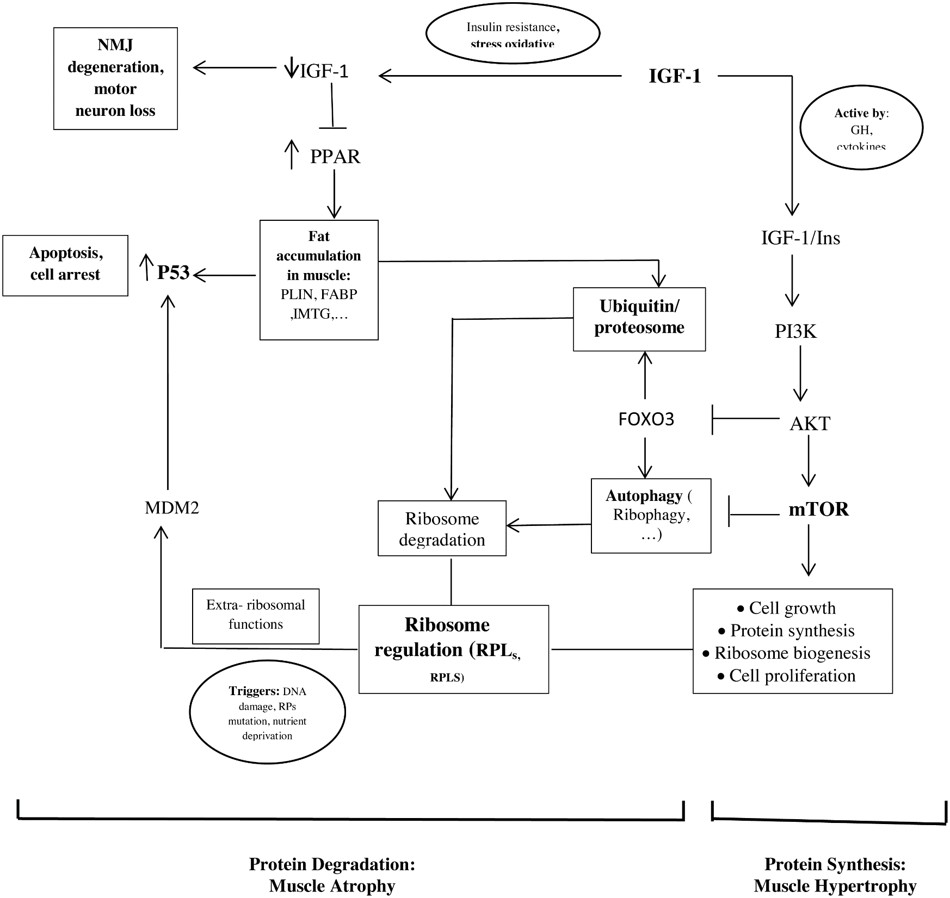
Schematic representations of the identified hub genes and proteins of muscle development

Slide 20
Network Logic
The neurotrophic factors expressed in skeletal muscle are essential for motoneuron survival and muscle fiber innervation during development
Neutrophins
TRK receptor
Ligands of
promoting survival and other functional regulation of cells
TRK receptor
Neutrophins
+

Slide 21
Their conclusion
“By integrating the analysis of multiple gene expression profiles, we have proposed that the ribosome biogenesis genes and those involved in lipid storage would be promising markers for sarcopenia in men and women, respectively. According to PPI network analysis, neurotrophic factors expressed in skeletal muscle are essential for motoneuron survival and muscle fiber innervation during development. Cullin E3 ubiquitin ligase (Cul3) is an important component of the ubiquitin–proteasome system which regulates the proteolysis. P53 is also recognized as a central regulator of the cell cycle and apoptosis. These hub proteins might be involved in aging muscle and sarcopenia. The important point of our study is that hub proteins and hub genes are interconnected. These results could be considered meaningful for future diagnosis and therapy of sarcopenia”

Slide 22
Their conclusion
“By integrating the analysis of multiple gene expression profiles, we have proposed that the ribosome biogenesis genes and those involved in lipid storage would be promising markers for sarcopenia in men and women, respectively. According to PPI network analysis, neurotrophic factors expressed in skeletal muscle are essential for motoneuron survival and muscle fiber innervation during development. Cullin E3 ubiquitin ligase (Cul3) is an important component of the ubiquitin–proteasome system which regulates the proteolysis. P53 is also recognized as a central regulator of the cell cycle and apoptosis. These hub proteins might be involved in aging muscle and sarcopenia. The important point of our study is that hub proteins and hub genes are interconnected. These results could be considered meaningful for future diagnosis and therapy of sarcopenia”

Slide 23
Their conclusion
“By integrating the analysis of multiple gene expression profiles, we have proposed that the ribosome biogenesis genes and those involved in lipid storage would be promising markers for sarcopenia in men and women, respectively. According to PPI network analysis, neurotrophic factors expressed in skeletal muscle are essential for motoneuron survival and muscle fiber innervation during development. Cullin E3 ubiquitin ligase (Cul3) is an important component of the ubiquitin–proteasome system which regulates the proteolysis. P53 is also recognized as a central regulator of the cell cycle and apoptosis. These hub proteins might be involved in aging muscle and sarcopenia. The important point of our study is that hub proteins and hub genes are interconnected. These results could be considered meaningful for future diagnosis and therapy of sarcopenia”

Slide 24
Their conclusion
“By integrating the analysis of multiple gene expression profiles, we have proposed that the ribosome biogenesis genes and those involved in lipid storage would be promising markers for sarcopenia in men and women, respectively. According to PPI network analysis, neurotrophic factors expressed in skeletal muscle are essential for motoneuron survival and muscle fiber innervation during development. Cullin E3 ubiquitin ligase (Cul3) is an important component of the ubiquitin–proteasome system which regulates the proteolysis. P53 is also recognized as a central regulator of the cell cycle and apoptosis. These hub proteins might be involved in aging muscle and sarcopenia. The important point of our study is that hub proteins and hub genes are interconnected. These results could be considered meaningful for future diagnosis and therapy of sarcopenia”

Slide 25
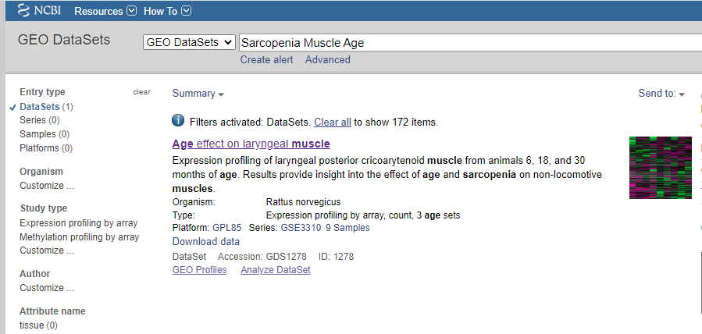
Data attainment and pre processing
Gene Expression Omnibus (GEO; http://www.ncbi.nlm.nih.gov/geo/)
: ‘‘sarcopenia,’’ ‘‘muscle,’’ and ‘‘age.’

Slide 26
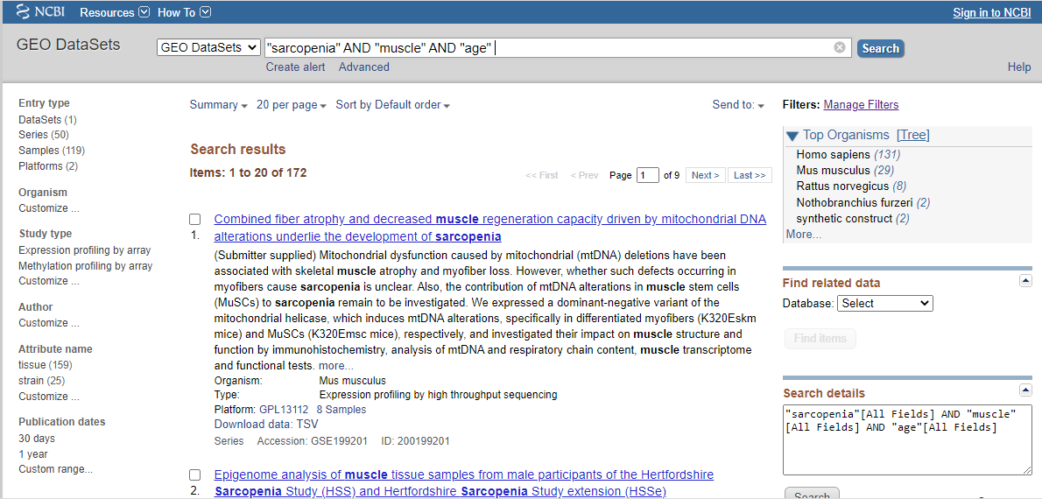
Data attainment and pre processing
Gene Expression Omnibus (GEO; http://www.ncbi.nlm.nih.gov/geo/)
: ‘‘sarcopenia,’’ ‘‘muscle,’’ and ‘‘age.’

Slide 27
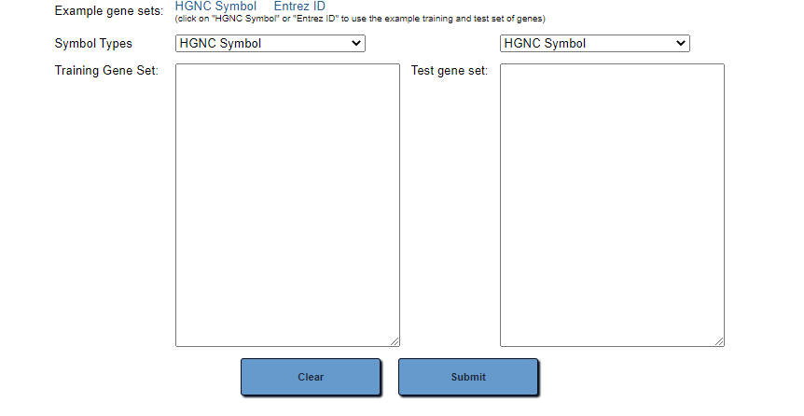
Plugins limitations
GeneMANIA will be slower with an input gene list of more than 50 genes; if you have such large gene lists, we recommend using a gene list of no more than 100 genes
cytoHubba no tutorials
BisoGen Not available
ToppGene pipeline is incomplete

Slide 28
Plugins limitations
GeneMANIA will be slower with an input gene list of more than 50 genes; if you have such large gene lists, we recommend using a gene list of no more than 100 genes
cytoHubba no tutorials
BisoGen Not available
ToppGene pipeline is incomplete
InnateDB Was not explained

Slide 29


